Slide 1
Read Write Inc. Phonics Parents’ Meeting Listening to your child read
Notes:
Approximately 20 minutes is needed for this session.
Notes are provided to help you lead the presentation.
Notes in italics are for your attention only.
Provide copies of ‘Reading at Home Booklet 1 or 2’ from Oxford Owl.
Booklet 1 is sound groups and Ditty/ Red Groups and Booklet 2 for Green – Grey Storybooks.
Children will make the best possible progress if they read as often as possible.
Today we are going to discuss how to listen to your child read their Read Write Inc. Phonics decodable storybook when they bring it home.

Slide 2
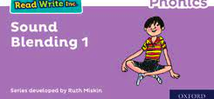
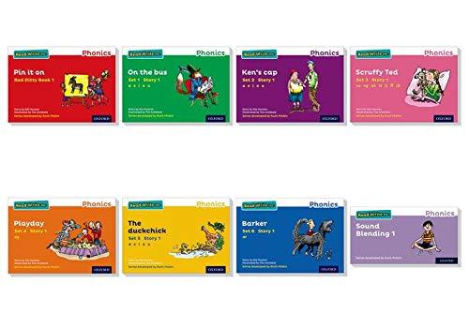
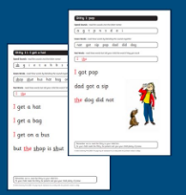
Read Write Inc
Children are grouped by their phonics level. Each half term teachers will assess and rearrange groups as needed. Children will only be given books that are decodable for them.

Slide 3
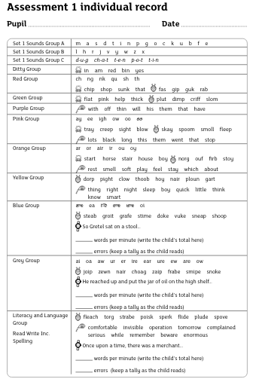

Slide 4
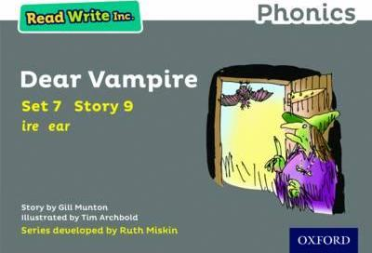
Colour coded books
Children will bring the book home that they have been reading at school. It is important that they read at home every day.

Slide 5
Re-reading the same book
Accuracy
Fluency
Comprehension
Read and enjoy at home
Notes:
In our school, children read each Read Write Inc. Storybook three times in class with their partner.
Re-reading the same book helps children to become confident readers. Each time they re-read, they build their fluency/speed and comprehension.
They love reading and want to read because they can read all of the words in the Storybook.
We set a focus for each re-read in school.
(Click) The first read focuses on reading every word accurately.
(Click) The second on reading the story more quickly.
(Click) The third read on comprehension - understanding what they read.
Then your child brings the same book home to read and enjoy with you again and again at home.
It’s ‘three with me, four at home.’
We do not send stories home the children cannot read because we always want them to be set up to succeed in their reading.
We want to make sure they enjoy reading so that they want to read.
The more they read, the faster progress they will make.

Slide 6
English alphabetic code
44 sounds
26 letters
Over 150+ graphemes (letter combinations)
One of the most complex alphabetic codes in the world.
Read Write Inc splits these into Set 1, Set 2 and Set 3 sounds. A digraph is called a 'special friend'.
Notes:
We use 44 sounds to make all the words in the English language. This means we’ve got a problem. We’ve got 44 sounds and only 26 letters.
The 26 letters work singly, in pairs and sometimes in threes to represent one sound.
We have to group letters together to write some sounds e.g. ‘igh’, ‘air’.
In English we have more than 150 ways to represent 44 sounds, using the 26 letters in the alphabet.
Click
This makes our language one of the most complex in the world!

Slide 7
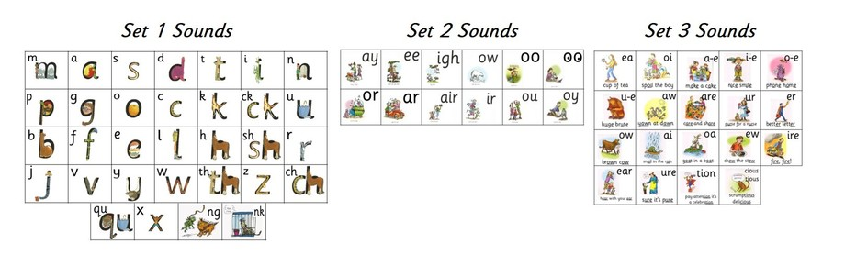

Slide 8
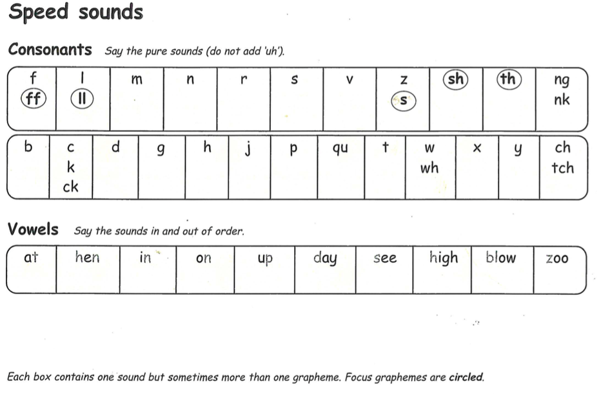
Activity 1: Speed Sounds
Notes:
Using RWI, we make learning to read easy for children because we start by teaching them just one way of reading and writing every sound. Here they are on the Simple Speed Sounds chart.
We teach Set 1 sounds first - (sounds as far as a e i o u). Each book has a sounds page to practice.
Children need to know sounds – not letter names – to read words.
Use MTYT to teach each of the Set 1 sounds to parents.

Slide 9
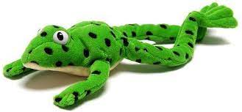
Orally blending before reading green words

Slide 10
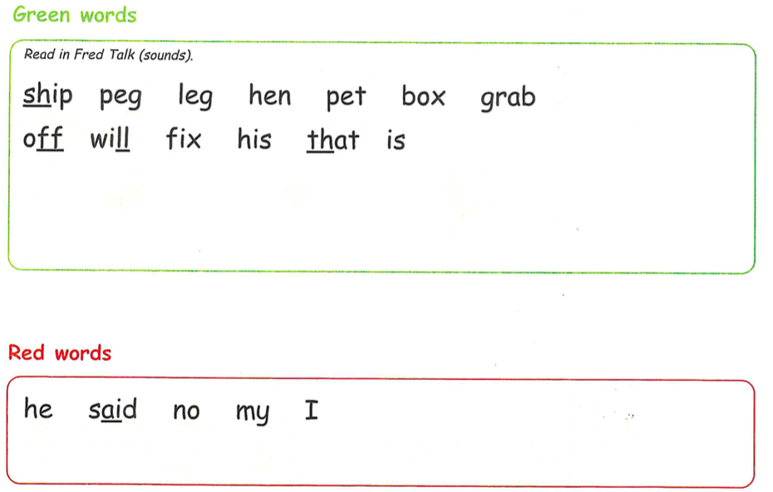
Activity 2: Green and red words
Notes:
Each book has a page containing all the green and red words from the book. Red words are words that are not decodable and need to be taught by sight.

Slide 11

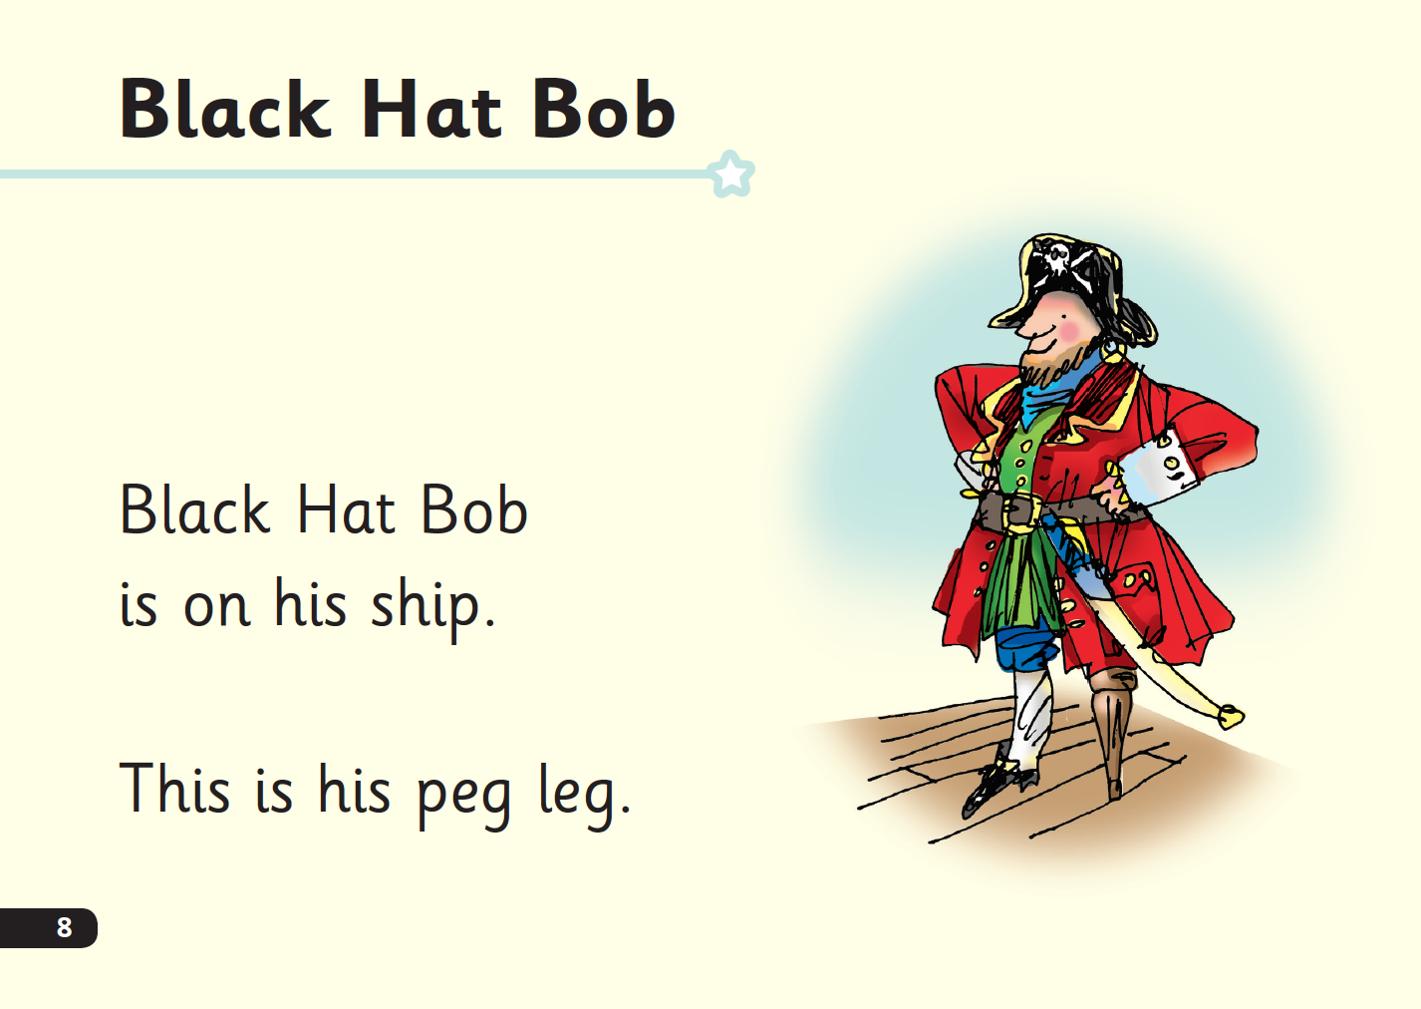
‘Special Friends’, ‘Fred Talk’, read the word
Notes:
Children will be able to read all of the words in the Storybook.
If they hesitate, remind them to read the word using ‘Special Friends, Fred Talk, read the word’.
For example, this means they spot the ‘sh’, then Fred Talk and blend to read the word e.g. sh, sh-i-p, ship.

Slide 12


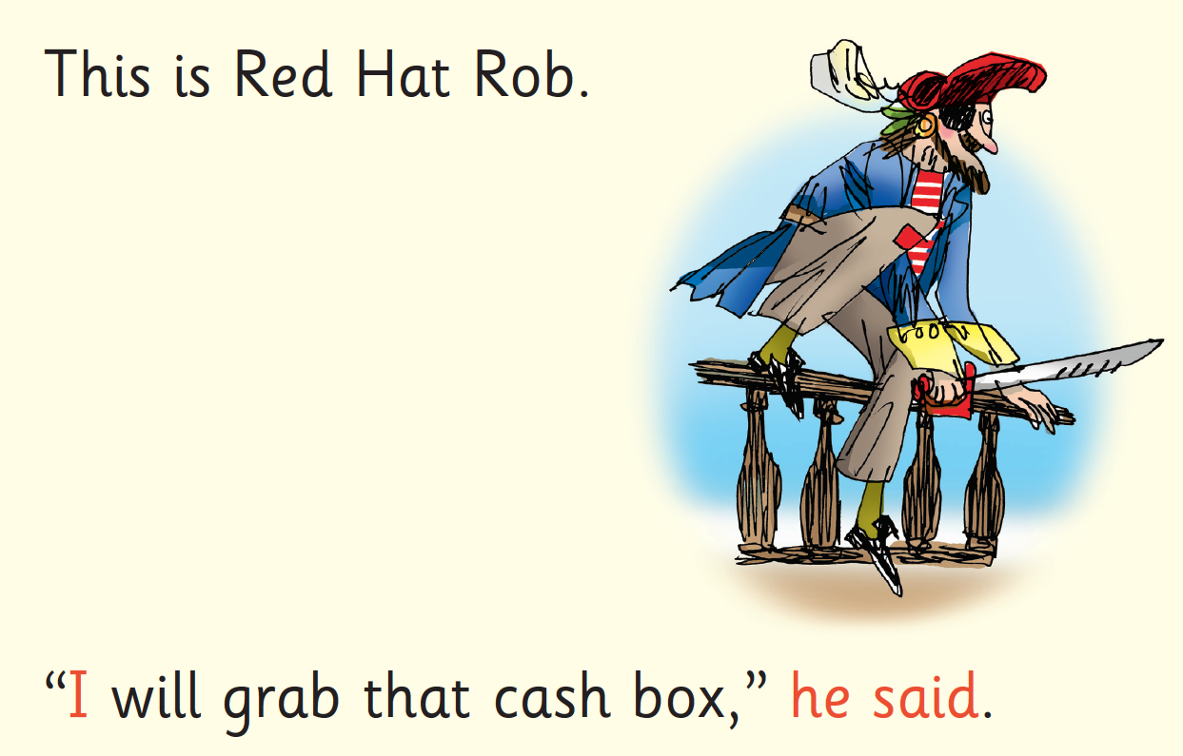
Red Words
Notes:
Some words are ‘tricky’ because they contain letters that don’t match the sounds the child has been taught.
For example, ‘said’ has ‘ai’ making an ‘e’ sound.
We teach these common exception words as Red words.
In the early Storybooks, these words are printed in red text.
Remind your child not to use Fred Talk to read Red words but instead to stop and think. Tell them the word if needed.

Slide 13
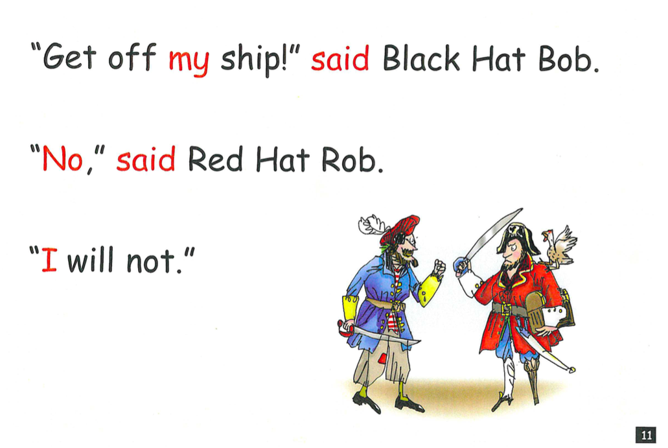
Activity 3: Read the story
Notes:
Your child will then read the story

Slide 14
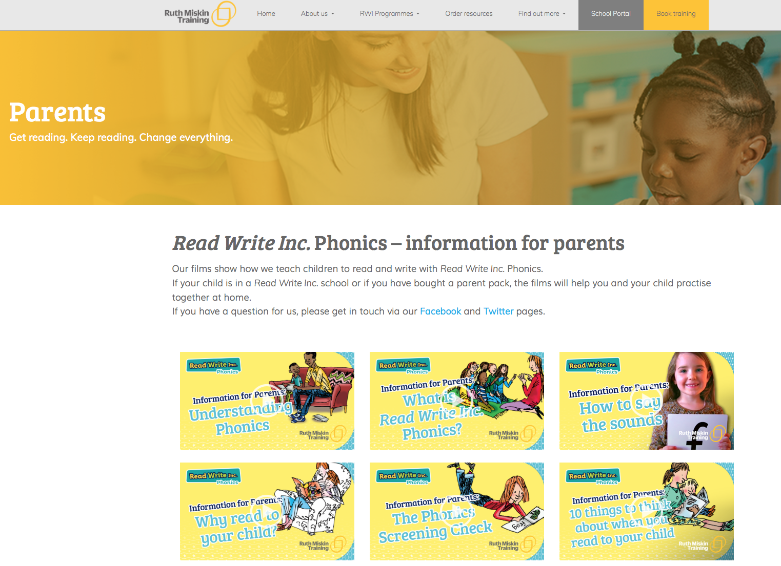
Free Video Tutorials (ruthmiskin.com)
Notes:
Watch these video tutorials on the Ruth Miskin website to help you to practise reading and writing with your child at home:
The frieze
reading the stretchy sounds with your child
reading the bouncy sounds with your child
Handwriting
I will also give you a copy of the ‘Reading at Home Booklet 1’.

Slide 15
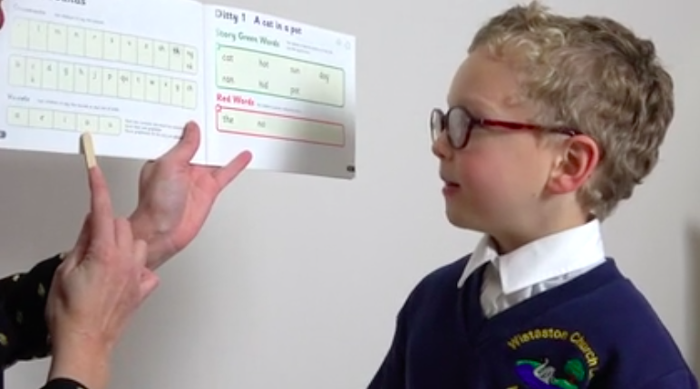
Point and sweep (not yellow, blue or grey)
Notes:
Let’s watch this child enjoying reading their Storybook again and again. Point and sweep until yellow books.
Show on portal – subscription – phonics – red ditty training – unit 3 sounds (partner practice and ditty) 1-1.24, green words 2.33-2.59
Show on portal as above but first read - .30 - 1.28 to show point and sweep

Slide 16

After the third read…
Please ensure the book is always left in your child’s book bag to ensure it is not lost or damaged. This will need to be in school every day.
A small fee of £3 will be charged for damaged or lost books to cover the cost of a replacement.
Notes:
So after the third read in class, children bring the same Storybook home in their book bag.
They love this book!
They can read it like a storyteller and can’t wait to read it to you, their grandparents or even their teddy bear.
Please avoid saying, “This book is too easy for you!” but instead say “I love how well you can read this book!”
They are meant to be able to read all of the words as the book is at the correct level.
Encourage them to share their enjoyment of the story with you and read it in their storyteller voice – again and again.

Slide 17
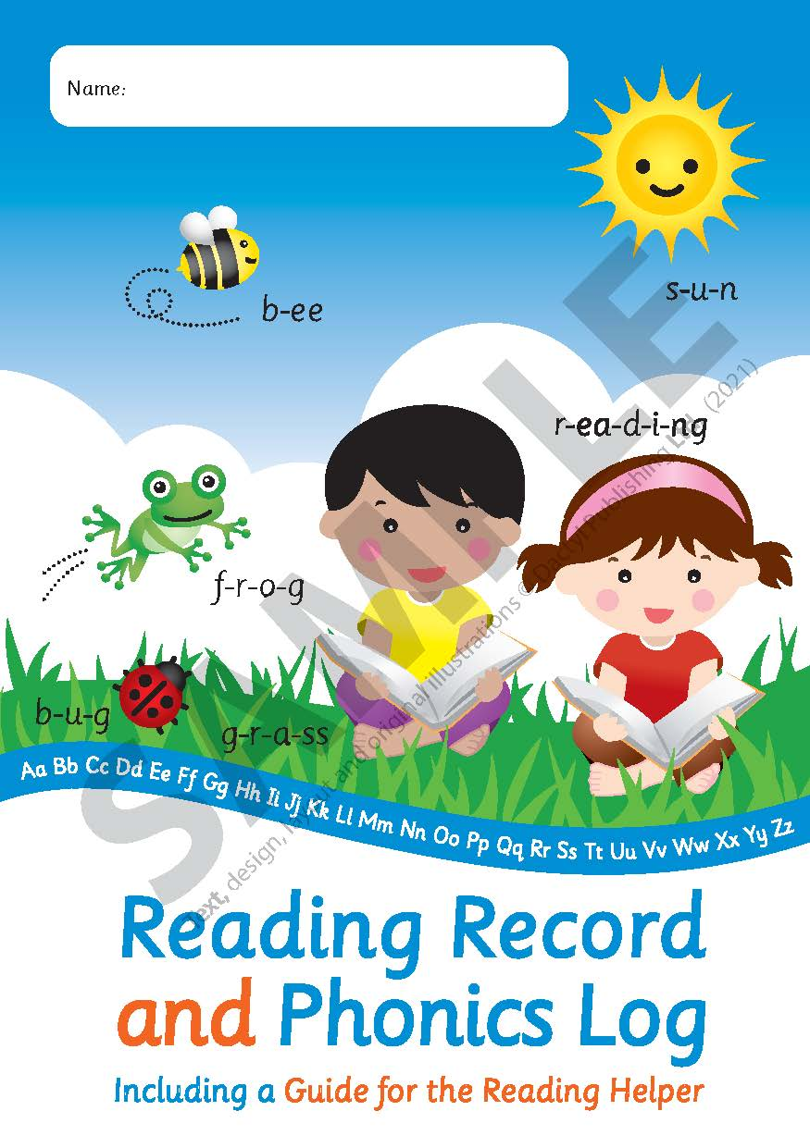
Which books will children bring home?
+
Please record each time you listen to your child read their book. It is important that your child reads the book and you listen. If your child struggles with a word, ask them to use their Fred Talk.
Notes:
In your child’s book bag, they will bring home:
- the Storybook they have read in class to practise reading what they can already read.
- a Book Bag Book. I’ll explain more about these in one moment.
We make sure that every book that goes into your child’s book bag is a well-loved book – one they know already and want to read again and again.

Slide 18


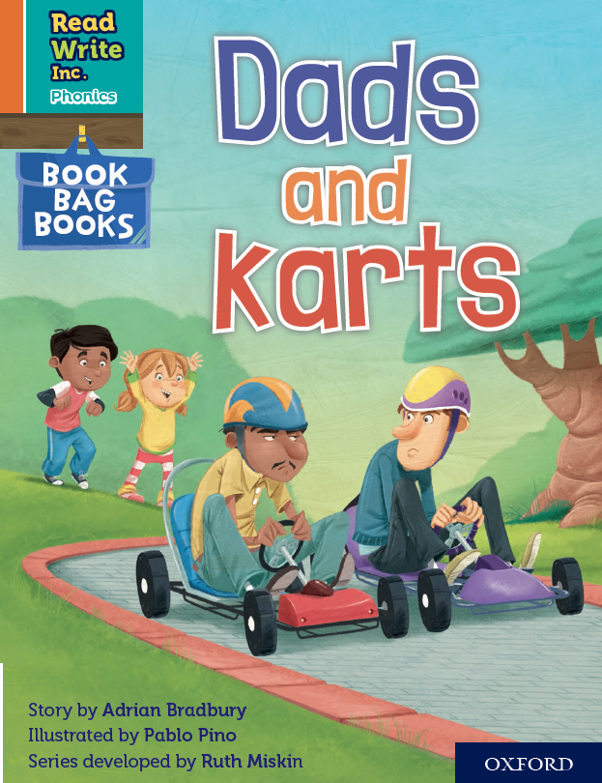

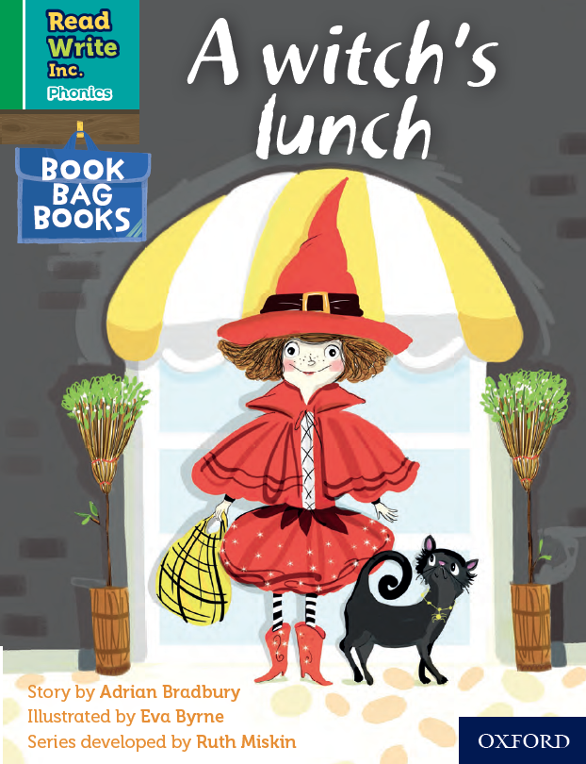
Book Bag Books – 1 or 2
Extra reading practice at home
Uniquely matched to the Read Write Inc. Phonics Storybooks.
Reinforce children's learning of phonics at the appropriate level.
Helps to make even faster progress in reading.
Notes:
Only use this slide if you use Book Bag Books in your school.
We use Book Bag Books especially for home reading. They have guidance inside just for you as parents.
They are matched to the books children read in school so provide practice of the same sounds – extra practice at the right level for your child.
They include many of the same reading activities that we use in class.

Slide 19
What can you do?
Listen to your child read the same Storybook again and again. At least once a day.
Encourage them to use ’Special Friends’, ‘Fred Talk’, ‘read the word’
Discuss the story and encourage their storyteller voice.
Help your child to sound out the letters in words and then ‘point and sweep’ the sounds together to make a whole word. Please do not refer to the letters by their names.
Help your child to focus on the ‘pure’ sounds. You can hear how to say the sounds correctly by searching on YouTube for ‘Read Write Inc. Phonemes Pronunciation Guide’.
Notes:
Provide copies of ‘Reading at Home Booklet 1 or 2’ from Oxford Owl.
Booklet 1 is sound groups and Ditty/ Red Groups and Booklet 2 for Green – Grey Storybooks.

Slide 20
Online resources available
Ruth Miskin Parents’ Page:
http://www.ruthmiskin.com/en/parents/
Ruth Miskin Facebook:
https://www.facebook.com/miskin.education
Free e-books for home reading:
http://www.oxfordowl.co.uk/Reading/

Slide 21

The more that you read, the more things you will know. The more that you learn, the more places you’ll go!
Dr. Seuss
Notes:
In the words of Dr Seuss…read quote.
Good readers do well in school – and in life.
By listening to your child read, you are making sure they have the opportunity to practise and become a good reader quickly.
Remember that all parents have the power to change outcomes for their children.

Slide 22
Any other questions
Q&A

